Slide 1
Azure IaaS

Slide 2
Agenda
Your services and Azure
Virtual Machines
Virtual Networks
Azure Resource Manager

Slide 3
Your service
Notes:
Slide Objectives:
Explain how Azure helps developers to refocus on their applications.
Speaker Notes:
Before we discuss about specifics, let’s refocus on what you care about – your application/service.
Azure is taking a application-centric approach and brings tools and services to support DevOps scenarios.

Slide 4
→ Your application code
→ Your infrastructure code
→ Required resources
Notes:
Slide Objectives:
Explain application is made up by application code and infrastructure code.
Speaker Notes:
Let’s start with something that you know inside-and-out: your application code. [click]
Then, for whatever reason, you decide to deploy your application to Azure. [click]
What you do is to allocate a bunch of related resources out of the humongous resource pool provided by Azure, deploy your application code to these resources, and you have a running service. [click]
For DevOps’ perspective, you need a way to reliable capture and apply your requirements on resources, which can be referred as infrastructure code.

Slide 5
You: Code (application, infrastructure)
Azure: Resources (IaaS, PaaS, SaaS)
Notes:
Slide Objectives:
Reiterate the point that to make your service successful, you are partnering with Azure. You bring the code, and Azure brings resources.
This slide also sets state for the talk by explaining how IaaS components fit into the overall picture.
Speaker Notes:
[Continue with previous slide]
To make your service successful, you are partnering with Azure. You bring the code, and Azure brings resources. [Click]
And you keep iterating and making improvements over time. [Click]
In terms of infrastructure code, you can use it to define desired states of required resources (Note: current Azure Resource Manager only support a small number of Resource Providers). [Click]
You can define hosting environments, such as websites, cloud services and VMs. [Click]
Required services. [Click]
In this session we’ll focus on infrastructural components including virtual machines and virtual networks.

Slide 6
Why Infrastructure as a Service?
Deploy anywhere with Azure as your data center
Run virtually any Windows or Linux based workload
Monitoring, scale, and automation is built in
Flexible hybrid connectivity options
Let’s compare a traditional vs. an Azure deployment

Slide 7




Deploying a Traditional N-Tier Infrastructure
Order Hardware
WEB
APP
SQL
Setup Network Infrastructure
Setup Server Infrastructure
Install and Patch OS
Install and Configure Apps
Multiple Environments?
Repeat steps
Networking Infrastructure
Routers, Switches, Cables, Load Balancing

Slide 8

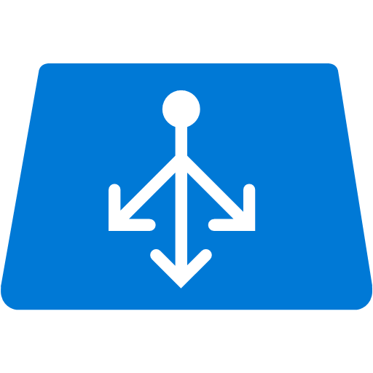
Deploying with Microsoft Azure IaaS Without automation
Configure Virtual Network
WEB
APP
SQL
Deploy VMs and Configure Load Balancer
Patch the OS
Install and Configure Apps
Multiple Environments?
Repeat steps
Networking Infrastructure
Mostly virtualized (IPSEC VPN or Routers)

Slide 9
Deploying with Microsoft Azure IaaS With automation
Identify Repeatable Processes
WEB
APP
SQL
Build Automation (scripts, templates, etc.)
Execute
Multiple Environments?
Change parameter(s) and re-execute
Networking Infrastructure
Mostly virtualized (IPSEC VPN or Routers)

Slide 10
Virtual Machines

Slide 11
Azure Virtual Machines
Launch Windows Server and Linux in minutes
Scale from 1 to 1000s of VM Instances
Save money with per-minute billing
Open and extensible
Notes:
Slide Objectives:
High-level selling points of virtual machines.
Speaker Notes:
Both Linux and Windows are supported. It’s important to reiterate on this as many developers are still not aware of this.
Mention scaling at enterprise level using DSC, Puppet or Chef.
Emphasize on the openness – we are not forcing your to lock on Microsoft technologies. Instead, Azure is more open than ever. You can leverage your existing skills, tools and services, and Azure is providing more and more first-class supports for them.

Slide 12


Provisioning VM
Getting Started
Select Image and VM Size
New Disk Persisted in Storage
Windows Server
Management Portal
Boot VM from New Disk
Linux
>_
General Purpose
Basic
Standard
Optimized Compute
Performance Optimized
Network Optimized
Scripting
(Windows, Linux and Mac)
Cloud
REST API
Notes:
Slide Objective:
Explain workflow for provisioning VMs in the cloud
Speaker Notes:
You have three methods of starting this process: Build a VM from the portal, from the command line OR programmatically calling the REST API.
Once your choice of provisioning is made you will need to select the image and instance size to start from.
The newly created disk will be stored in blob storage and your machine will boot.

Slide 13

















VM Gallery
A collection of prebuilt images for various workloads
Windows Server 2012 R2
Ubuntu Server 14.04 LTS
CentOS 6.5
SUSE Linux
Enterprise Server
openSUSE 13.1
Oracle Linux 6.4.0.0.0
SQL Server 2014 Standard
Oracle Database 11g R2
SharePoint Server Farm
Microsoft Dynamics
GP 2013
Zulu 8
BizTalk Server 2013
SAP HANA
Developer Edition
Puppet Enterprise 3.2.3
Barracuda Web Application
Oracle WebLogic
Server 12.1.2
Visual Studio Ultimate 2013
Windows 8.1 Enterprise
Notes:
Slide Objective:
Explain a wide variety of images that you can choose from.
Speaker Notes:
First of all, you can choose from different Windows Servers and a variety of Linux implementations. [Click]
As well as pre-built images for different flavors of SQL Database and Oracle databases. [Click]
You can also choose from a number of first-party and certified third-party images for various application servers and infrastructural components. [Click]
And last but not least, if you are a MSDN subscriber, you also have access to Visual Studio images and client Windows systems such as Windows 7 and Windows 8.1 for your DevTest purposes.

Slide 14
Virtual Machine Sizes
General Purpose compute: Basic
General Purpose compute: Standard
Optimized Compute
Performance Optimized
Network Optimized
Notes:
Slide Objective:
Introduce different virtual machine sizes.
Speaker Notes:
http://azure.microsoft.com/en-us/pricing/details/virtual-machines/

Slide 15
General Purpose Compute
Basic Tier
An economical option for development workloads, test servers, and other applications that don't require load balancing, auto-scaling, or memory-intensive virtual machines.
Instance | Cores | RAM | Disk sizes
A0 | 1 | 0.75 GB | 20 GB
A1 | 1 | 1.75 GB | 40 GB
A2 | 2 | 3.5 GB | 60 GB
A3 | 4 | 7 GB | 120 GB
A4 | 8 | 14 GB | 240 GB

Slide 16
General Purpose Compute
Standard Tier
Offers the most flexibility. Supports all virtual machine configurations and features
Instance | Cores | RAM | Disk sizes
A0 | 1 | 0.75 GB | 20 GB
A1 | 1 | 1.75 GB | 70 GB
A2 | 2 | 3.5 GB | 135 GB
A3 | 4 | 7 GB | 285 GB

Slide 17
General Purpose Compute
Standard Tier
Offers the most flexibility. Supports all virtual machine configurations and features
Instance | Cores | RAM | Disk sizes
A4 | 8 | 14 GB | 605 GB
A5 | 2 | 14 GB | 135 GB
A6 | 4 | 28 GB | 285 GB
A7 | 8 | 56 GB | 605 GB

Slide 18
General Purpose Compute
Network optimized with Infiniband support
Adds a 40Gbit/s InfiniBand network with remote direct memory access (RDMA) technology.
Instance | Cores | RAM | Disk sizes
A8 | 8 | 56 GB | 382 GB
A9 | 16 | 112 GB | 382 GB
Adds a 40Gbit/s InfiniBand network with remote direct memory access (RDMA) technology. Ideal for Message Passing Interface (MPI) applications, high-performance clusters, modeling and simulations, video encoding, and other compute or network intensive scenarios.

Slide 19
General Purpose Compute
Optimized Compute (D Tier)
60% faster CPUs, more memory, and local SSD
Instance | Cores | RAM | Disk sizes
D1 | 1 | 3.5 GB | 50 GB
D2 | 2 | 7 GB | 100 GB
D3 | 4 | 14 GB | 200 GB
D4 | 8 | 28 GB | 400 GB

Slide 20
General Purpose Compute
Optimized Compute (D Tier)
60% faster CPUs, more memory, and local SSD
Instance | Cores | RAM | Disk sizes
D11 | 2 | 14 GB | 100 GB
D12 | 4 | 28 GB | 200 GB
D13 | 8 | 56 GB | 400 GB
D14 | 16 | 112 GB | 800 GB

Slide 21
General Purpose Compute
Performance Optimized Compute (G Tier)
Unparalleled computational performance with latest CPUs, more memory, and more local SSD
Instance | Cores | RAM | Disk sizes
G1 | 2 | 28 GB | 384 GB
G2 | 4 | 56 GB | 768 GB
G3 | 8 | 112 GB | 1,536 GB
G4 | 16 | 224 GB | 3,072 GB
G5 | 32 | 448 GB | 6,144 GB

Slide 22
Demo: Managing VMs using Azure portal
Notes:
Demo: Provisioning VM
Prerequisites:
A Windows Server 2012 is already provisioned.
Steps:
Open Ibiza portal and click the NEW button at the lower-left corner.
Show the short list of resources. Explain that I can directly create popular resources here such as a Windows Server 2012.
Click on the Everything link.
In Gallery blade, open the Virtual machines category.
Scroll down the view and show images of different types (refer back to slide 9).
Click on Windows Server 2012 R2, and then click the Create button in the overview blade. For non-Microsoft focused audience, consider to pick a Linux image instead.
Fill in the Create VM form and click on the Create button to provision the VM. Explain this will take a few minutes.
Open the already provisioned VM.
Scroll down the blade to show various of information available on the blade.
Click on the Extensions tile.
On the Extensions blade, click on the ADD icon to bring up the extension list. Introduce that VM extensions are installable components to customize VM instances.
Switch to slides to continue with VM extension introduction.

Slide 23

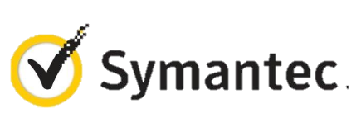




VM Extensions
Installable components to customize VM instances
Enable various DevOps scenarios
Can be added, updated, disabled or removed at any time
Managed via portal, PowerShell and Management APIs
Microsoft Azure
Notes:
Slide Objective:
Introduce VM extensions.
Speaker Notes:
No matter how big the image gallery is, your projects may have specific needs that can’t be satisfied by standard images.
Some components such as anti-virus, configuration management agents are required on most machines for compliance and management purposes.
This allows use to innovate faster to meet with your project needs. And you have flexibility to pick and combine extensions for your goals.
Point out some of existing extensions:
Custom Script Extension, which allows you to download and execute PowerShell scripts.
Chef Extension and Puppet Extension for automated management at scale.
Symantec Endpoint Protection etc. for protection.
Docker (Linux only).
Visual Studio Remote Debugger.

Slide 24
Data Persistence
Data Disks
Azure Files

Slide 25
Disks and Images
OS Images
Microsoft
Partner
User
Base OS image for new Virtual Machines
Sys-Prepped/Generalized/Read Only
Created by uploading or by capture
Disks
OS Disks
Data Disks
Writable Disks for Virtual Machines
Created during VM creation or during upload of existing VHDs.
Notes:
Slide Objective:
Explain the differences between disks and images with VMs

Slide 26
Image Mobility
On-Premises
Cloud
MyApp.vhd
Notes:
Slide Objective:
Explain the benefits of image mobility
Notes:
One of the key benefits of IaaS is flexibility and control. The Microsoft Azure solution provides the capability of not only moving VHDs TO the cloud but also allows you to copy the VHD back down and run it locally or on another cloud provider. Great for testing out production issues or any other need where you require a copy of the production server.

Slide 27
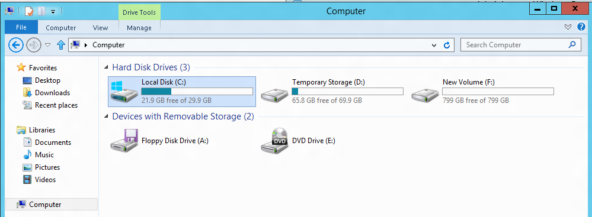
VM disk layout
OS Disk
Persistent
SATA
Drive C:
Temporary Storage Disk
Local (Not Persistent)
SATA
Drive D:
Data Disk(s)
Persistent
SCSI
Customer Defined Letter

Slide 28

Persistent Disks and Highly Durable
Microsoft Azure Storage (Disaster Recovery)
Microsoft Azure Storage
Virtual
Machine
Virtual Machine
Notes:
Slide Objective:
Explain how disks are durable and how Microsoft Azure storage works
Notes:
The OS and Data Disks are stored in Microsoft Azure storage. So in addition to the data being persistent you also get the benefits of storage which means your VHD is replicated 3X’s locally and also 3X’s in a separate data center in the same region (geo-replication)

Slide 29
Azure Files
Shared Network File Storage for Azure
Availability, durability, scalability are managed automatically
Supports two interfaces: SMB and REST
IaaS VM
IaaS VM
IaaS VM
PaaS VM
Azure File Share
(PaaS)

Slide 30
Azure Files Scenarios
Share data across VMs and applications
Multiple writers, multiple readers using standard file system semantics.
Share settings throughout services
VMs can read settings and files from a common, shared location. These can be updated externally via REST.
Dev/Test/Debug
Very useful to have a shared location for installing applications, setting up VMs, running tools, and keeping notes while developing, testing, and debugging cloud services.

Slide 31
Virtual Machine Availability
Meaning of 9’s
Fault domains, update domains and availability sets
Load balancing

Slide 32
Meaning of 9’s
Service Availability(%) | System Type | Annualized Down Minutes | Quarterly Down Minutes | Monthly Down Minutes | Practical Meaning | FAA rating
90 | Unmanaged | 52,596.00 | 13,149.00 | 4,383.00 | Down 5 weeks per year
99 | Managed | 5,259.60 | 1,314.90 | 438.30 | Down 4 days per year | ROUTINE
99.9 | Well managed | 525.96 | 131.49 | 43.83 | Down 9 hours per year | ESSENTIAL
99.99 | Fault tolerant | 52.60 | 13.15 | 4.38 | Down 1 hour per year
From Generic Requirements for Operation Systems Platform Reliability, Telcordia Technologies System Documentation,GR-2841-CORE and
Federation Aviation Administration Handbook: Reliability, Maintainability, and Availability (RMA) Handbook, FAA-HDBK-006A, Jan 7, 2008.
Microsoft Azure

Slide 33
Meaning of 9’s
Service Availability(%) | System Type | Annualized Down Minutes | Quarterly Down Minutes | Monthly Down Minutes | Practical Meaning | FAA rating
99.999 | High availability | 5.26 | 1.31 | 0.44 | Down 5 minutes per year | CRITICAL
99.9999 | Very high availability | 0.53 | 0.13 | 0.04 | Down 30 seconds per year
99.99999 | Ultra availability | 0.05 | 0.01 | - | Down 3 seconds per year | SAFETY CRITICAL
From Generic Requirements for Operation Systems Platform Reliability, Telcordia Technologies System Documentation,GR-2841-CORE and
Federation Aviation Administration Handbook: Reliability, Maintainability, and Availability (RMA) Handbook, FAA-HDBK-006A, Jan 7, 2008.
Microsoft Azure

Slide 34

Service Level Agreements
99.95% for multiple role instances
4.38 hours of downtime per year
What’s included
Compute Hardware failure (disk, CPU, memory)
Datacenter failures - Network failure, power failure
Hardware upgrades, Software maintenance – Host OS Updates
What is not included
VM Container crashes, Guest OS Updates

Slide 35
Fault and Update Domains
Fault Domain
Fault Domain
Rack
Rack
Web Role
UD #1
UD #2
INSTANCE
INSTANCE
INSTANCE
INSTANCE
Worker Role
UD #1
UD #2
INSTANCE
INSTANCE
INSTANCE
INSTANCE
Notes:
Slide Objective:
Provide a graphical view of fault and upgrade domains for existing web and worker roles. Use to contrast existing skills with availability sets.
Notes:
You can see that our service is well spread out across both fault and upgrade domains
The loss of a fault domain will not cause a failure of our service nor will the restart or change of an upgrade domain cause a failure of our service
Notes
Useful pre-reading here.
http://blog.toddysm.com/2010/04/upgrade-domains-and-fault-domains-in-windows-azure.html

Slide 36
Virtual Machine Availability Sets
Update Domains are honored by host OS updates
Fault Domain
Fault Domain
Rack
Rack
Availability Set
Virtual Machine
Virtual Machine
IIS1
IIS2
UD #1
UD #2
Availability Set
Virtual Machine
Virtual Machine
SQL1
SQL2
UD #1
UD #2
Notes:
Slide Objective:
Explain availability sets
Notes:
Availability sets tell the Fabric Controller to place VMs in the same set on different racks for faults and in separate upgrade domains for updates.
This essentially tells the FC not to take the guest OS down of all VMs in the same set for host updates.

Slide 37
Load balancing
Load balancing
Multiple VMs share the workload via public facing endpoints
Internal Load balancing
Load balancing between VMs that don’t have public facing endpoints
Microsoft Azure
Internet
Public VIP
Customer vNet
External Load Balancer
Internal Load Balancer
Microsoft Azure
Back end
Front end

Slide 38
Traffic Manager
Load balancing
Failover
US West
North Europe
Microsoft Azure
North America
Europe

Slide 39

Transform the datacenter Orchestrated disaster recovery to a second site
Microsoft Azure Hyper-V Recovery Manager
Communication Channel
Replication channel: Hyper-V Replica
Windows Server
Primary Site
Recovery Site
Windows Server

Slide 40
Transform the datacenter Orchestrated disaster recovery to a second site or to Azure
Microsoft Azure Site Recovery
Microsoft Azure Site Recovery
Communication Channel
Communication and Replication
Replication channel: Hyper-V Replica
Windows Server
Primary Site
Recovery Site
Windows Server
Primary Site
Windows Server
Key features include:
Automated VM protection and replication
Remote health monitoring
Customizable recovery plans
No-impact recovery plan testing
Orchestrated recovery when needed
Notes:
Speaker Note:
Consider this demo if time permits:
https://microsoft-my.sharepoint.com/personal/mmcspirt_microsoft_com/Documents/Shared%20with%20Everyone/BCDR
The specific demo is Azure Site Recovery – Between Sites.exe

Slide 41


Microsoft Azure Key Vault
Key Vault offers an easy, cost-effective way to safeguard keys and other secrets used by cloud apps and services using HSMs.
You manage your keys and secrets
Applications get high performance access to your keys and secrets… on your terms
Microsoft Azure
IaaS
PaaS
SaaS
Key Vault
Import keys
HSM
Notes:
Azure Key Vault offers an easy, cost-effective way to safeguard keys and other secrets used by cloud apps and services. With Key Vault, customers can streamline key management and maintain control of keys used to access and encrypt their data.

Slide 42
Enhance data protection and compliance
Increased security
HSM protected keys
Compliance
Monitoring
Encrypt keys and small secrets like passwords using keys protected by tightly controlled and monitored Hardware Security Modules (HSMs)
Import or generate your keys in HSMs for added assurance – so that keys stay within the HSM boundary
Comply with regulatory standards for secure key management, including the US Government FIPS 140-2 Level 2 and Common Criteria EAL 4+
Monitor and audit key use through Azure logging – pipe logs into HDInsight or your SIEM for additional analysis (coming soon)
Notes:
Enhance data protection and compliance
Encrypt keys and small secrets like passwords using keys stored in tightly controlled and monitored Hardware Security Modules (HSMs)
Import or generate your keys in HSMs for added assurance. Key Vault is designed so that keys stay within the HSM boundary
Comply with regulatory standards for secure key management, including the US Government FIPS 140-2 and Common Criteria EAL 4+
Monitor and audit key use through Azure logging – pipe logs into HDInsight or your SIEM for additional analysis (coming soon)

Slide 43
Azure Resource Manager

Slide 44
Azure Resource Manager Overview
Application Lifecycle Container
Available in Preview Portal
Consistent Management Layer
Resources are created into a Resource Group explicitly
ARM Template (JSON)
PowerShell
Azure CLI tools
Portal creation experience coming soon
Microsoft Azure

Slide 45
Azure Resource Groups
Containers of multiple Resources
Every Resource must exist in one and only one Resource Group
Unit of management
Lifecycle
Identity
Grouping
Microsoft Azure

Slide 46
Azure Resource Manager Templates
Azure Templates can:
Ensure Idempotency
Simplify Orchestration
Provide Cross-Resource Configuration and Update Support
Azure Templates are:
Source file, checked-in
Specifies resources and dependencies (VMs, WebApps, DBs) and connections (config, LB sets)
Parametrized input/output
SQL-A
Website
Instantiation of repeatable config.
Configuration → Resource Group
[SQL CONFIG] VM (2x)
DEPENDS ON SQL
DEPENDS ON SQL
SQL - A
Website
Virtual
Machines
SQL
CONFIG
Microsoft Azure

Slide 47
Power of Repeatability
SQL-A
Website
Instantiation of repeatable config.
Configuration → Resource Group
Azure Templates can:
Ensure Idempotency
Simplify Orchestration
Provide Cross-Resource Configuration and Update Support
Azure Templates are:
Source file, checked-in
Specifies resources and dependencies (VMs, WebApps, DBs) and connections (config, LB sets)
Parametrized input/output
[SQL CONFIG] VM (2x)
DEPENDS ON SQL
DEPENDS ON SQL
SQL - A
Website
Virtual
Machines
SQL
C
ONFIG

Slide 48
Try [service] today
Ask Questions:
Twitter:
Email
Public forum:

Slide 49
Q&A

Slide 50


Get started
Visit azure.microsoft.com

